Slide 1
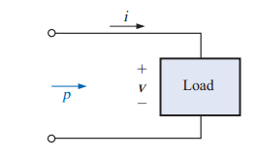
Power (ac)
We will now examine the total power equation in a slightly different form and will introduce two additional types of power: apparent and reactive.
For any system such as in Fig. 19.1, the power delivered to a load at any instant is defined by the product of
the applied voltage and the resulting current; that is,
Substituting the above equations for v and i into the power equation will result in
If we now apply a number of trigonometric identities, the following form for the power equation will result: where V and I are the rms values
If Equation above is expanded to the form
RESISTIVE CIRCUIT
where VI is the average or dc term and -VIcos 2qt is a negative cosine wave of either input quantity ( v or i) and a peak value of VI.
T1 = period of input quantities T2 = period of power curve pR
The total power delivered to a resistor will be dissipated in the form of heat.
with twice the frequency
The average (real) power

Slide 2
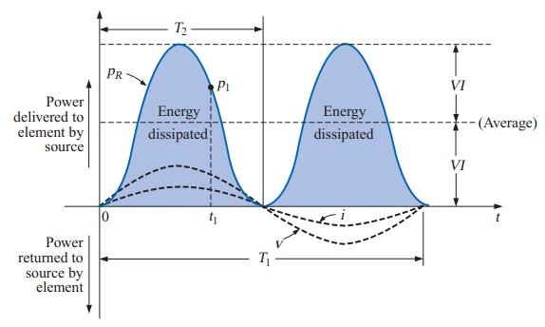
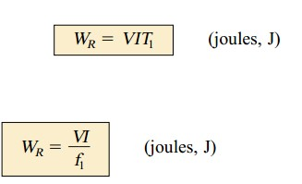
Power versus time for a purely resistive load. The energy dissipated by the resistor (W_{R}) over one full cycle
where P is the average value and t is the period of the applied voltage
The power factor of a circuit, therefore, is the ratio of the average power to the apparent power. For a purely resistive circuit, we have
APPARENT POWER
the maximum rating of a number of electrical components and systems. It is called the apparent power and is represented symbolically by S. Since it is simply the product of voltage and current, its units are volt-
amperes, for which the abbreviation is VA. Its magnitude is determined by

Slide 3
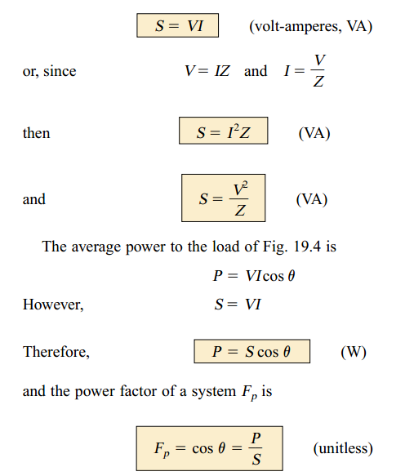
INDUCTIVE CIRCUIT AND REACTIVE POWER
For a purely inductive circuit
The power curve for a purely
inductive load.
T1 = period of either input quantity T2 = period of p_{L} curve
The net flow of power to the pure (ideal) inductor is zero over a full cycle, and no energy is lost in the transaction. reactive power associated with a pure inductor. The symbol for reactive power is Q, and
its unit of measure is the volt-ampere reactive (VAR).
The Q is derived from the quadrature (90°) relationship between the various powers. Therefore,

Slide 4
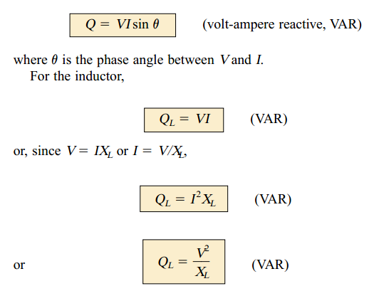
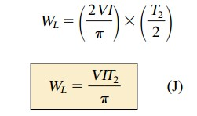
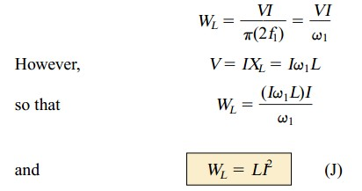
The apparent power associated with an inductor is S = VI, and the average power is P = 0, The power factor is
The energy stored by the inductor
where P is the average value for the interval and t is the associated interval of time.
the average value of the positive portion of a sinusoid equals 2(peak value/ π) and t = T2/2. Therefore
CAPACITIVE CIRCUIT

Slide 5
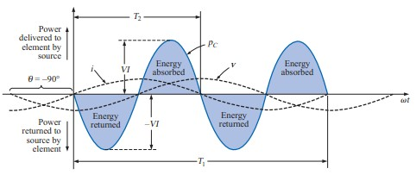
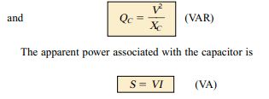
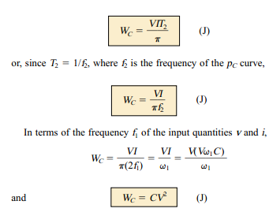
The power curve for a purely capacitive load. T1 = period of either input quantity
T2 = period of p_{C} curve
The net flow of power to the pure (ideal) capacitor is zero over a full cycle,
The energy stored by the capacitor during the positive portion of the cycle is equal to that returned during the negative portion and can be determined using the equation W = Pt .
THE POWER TRIANGLE
The three quantities average power, apparent power, and reactive power can be related in the vector domain by

Slide 6
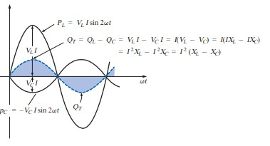
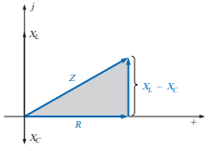
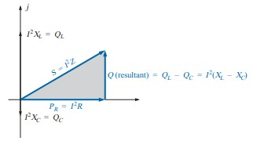
Inductive load
capacitive load
Since the reactive power is defined as the peak value, the reactive component of the power triangle is as indicated in the figure: I2(XL - XC).

Slide 7
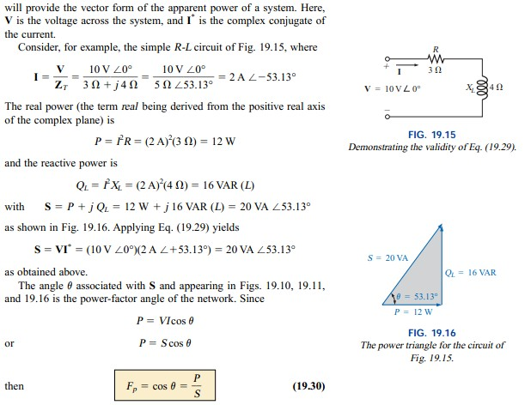
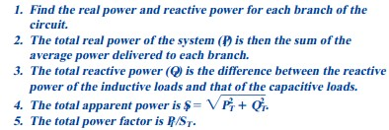
THE TOTAL P, Q , AND S

Slide 8
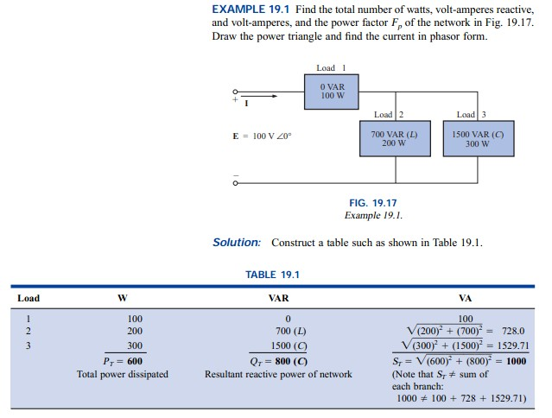
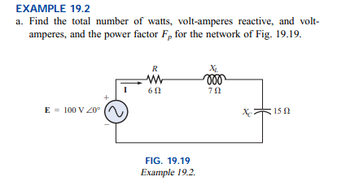

Slide 9
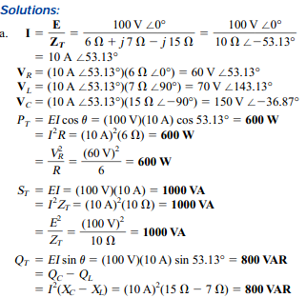
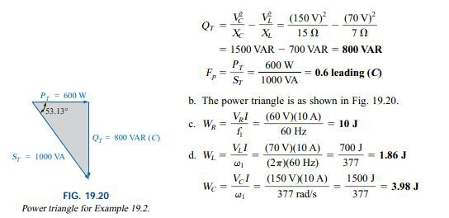
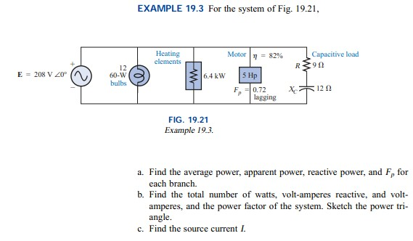

Slide 10
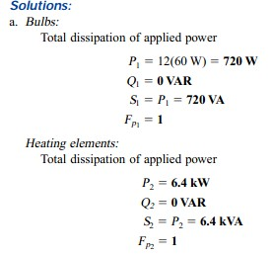
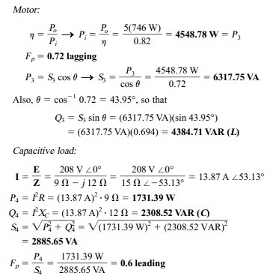
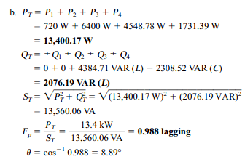

Slide 11
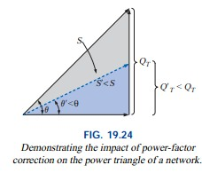
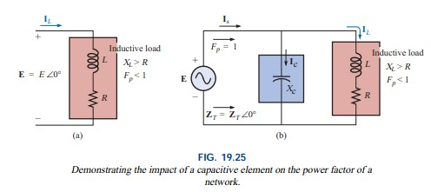
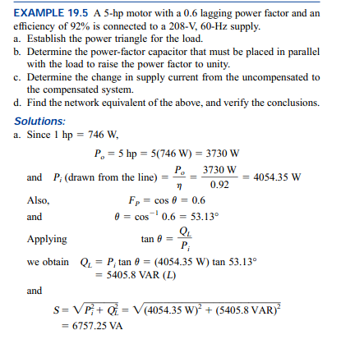
POWER-FACTOR CORRECTION
The process of introducing reactive elements to bring the power factor closer to unity is called power- factor correction. Since most loads are inductive, the process normally involves introducing elements with capacitive terminal characteristics having the sole purpose of improving the power factor.

Slide 12
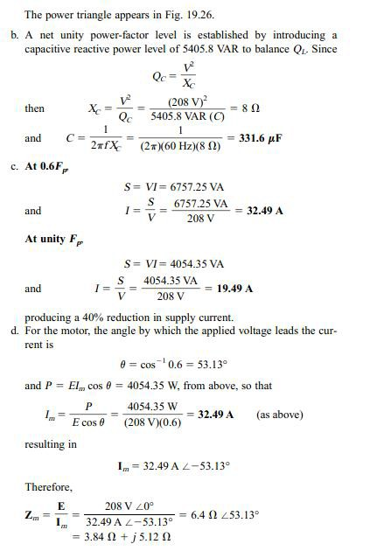
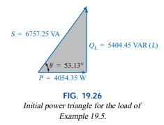

Slide 13
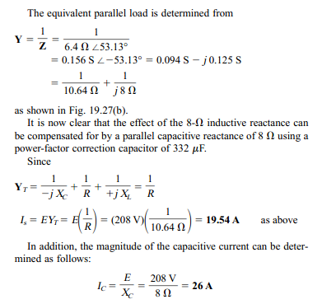
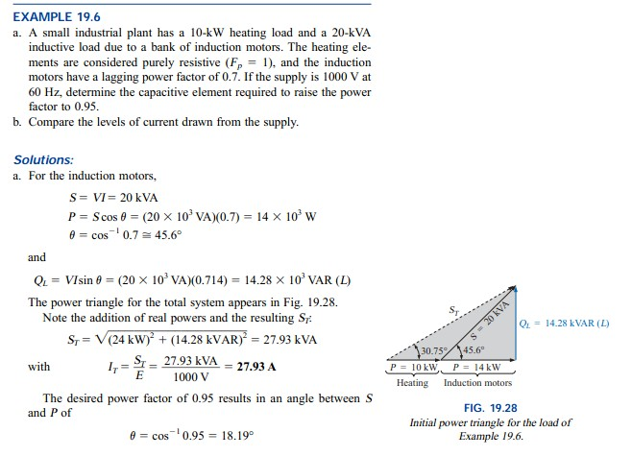

Slide 14
